Slide 1
Proportion Problems including money problems
J.Wilson

Slide 2
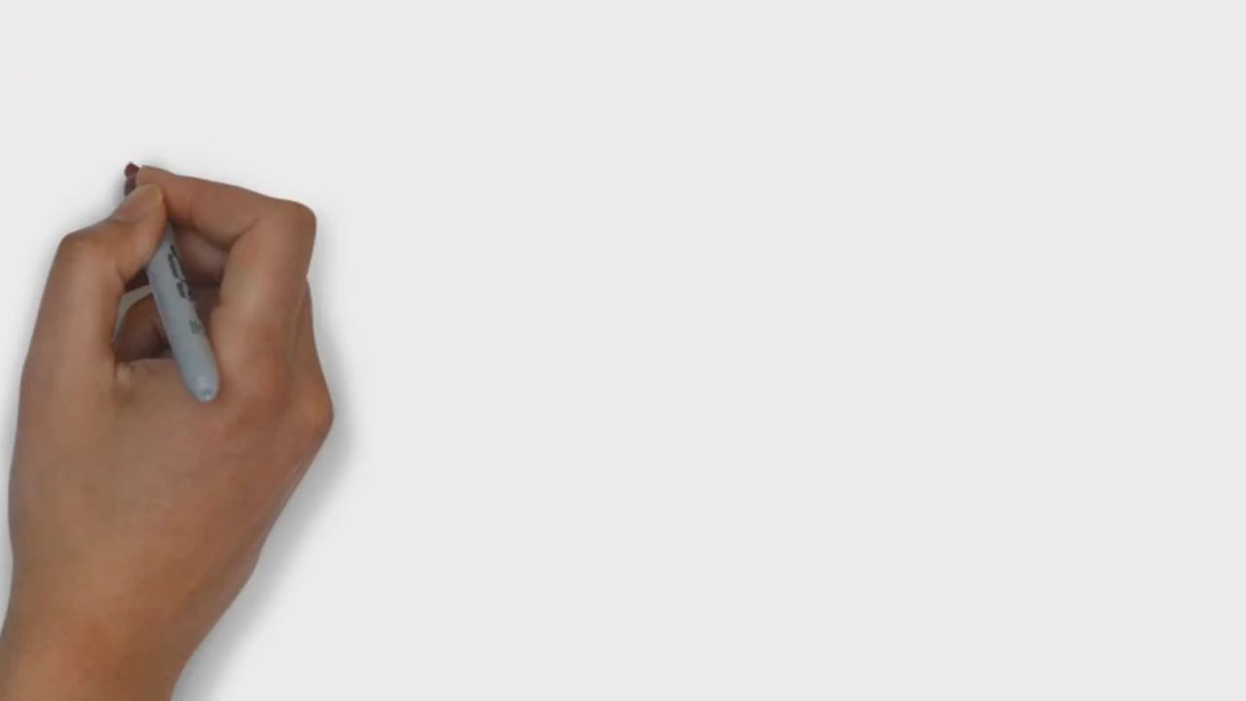

Slide 3
Topic : Proportion Problems
24
7
30
Date
EQ : What are some of the problems we can solve with proportion?
Proportion can be used to solve a number of problems that involve money. It can also be used to solve problems of scale.
We can use a graph or cross multiplication to help us solve these.

Slide 4
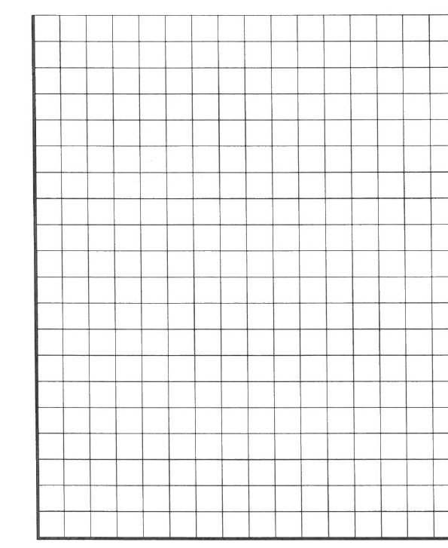

If the price of steak is $32 per kilogram, how much would 500g cost?
$32:1Kg = x :500g
$32:1Kg = x : 0.5kg
Begin by converting these into the same units.
We can also solve using a graph.
Since it is proportional, we know it must form a straight line that goes through the origin.
$ Kg
32 : 1
x : 0.5
$32 ×0.5$= $x×1$
$16=1x$
$\$16=x$
$
34
32
30
28
26
24
22
20
18
16
14
12
10
8
6
4
2
0
0.5 1 Kg

Slide 5
Exchange rates are used to work out how much something is worth in another currency.
Example
$1 Aus : $1.08 NZ means that something that cost $1 in Australia costs $1.08 in NZ. These are proportionate. So how much would a watch cost in New Zealand if it is $23 in Australian dollars.
Aus NZ

Slide 6
Exchange rates are used to work out how much something is worth in another currency.
Example
$1 Aus : $1.08 NZ means that something that cost $1 in Australia costs $1.08 in NZ. These are proportionate. So how much would a watch cost in New Zealand if it is $23 in Australian dollars.
Aus NZ
$1 costs $1.08
$23 costs $ x

Slide 7
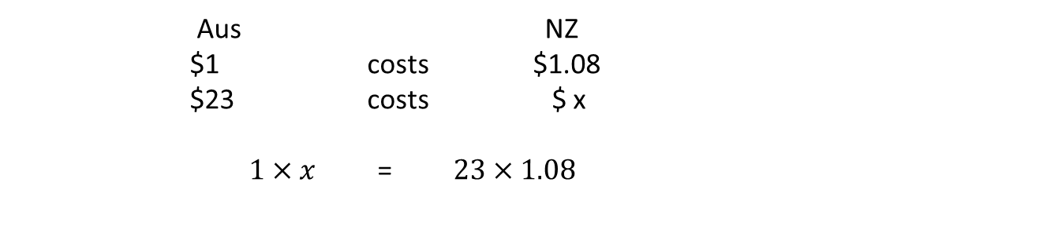
Exchange rates are used to work out how much something is worth in another currency.
Example
$1 Aus : $1.08 NZ means that something that cost $1 in Australia costs $1.08 in NZ. These are proportionate. So how much would a watch cost in New Zealand if it is $23 in Australian dollars.
Aus NZ
$1 costs $1.08
$23 costs $ x
$1×x$ = $23×1.08$

Slide 8
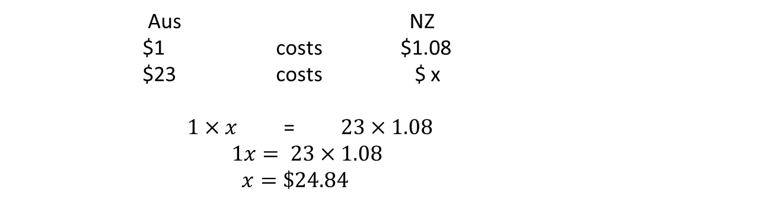
Exchange rates are used to work out how much something is worth in another currency.
Example
$1 Aus : $1.08 NZ means that something that cost $1 in Australia costs $1.08 in NZ. These are proportionate. So how much would a watch cost in New Zealand if it is $23 in Australian dollars.
Aus NZ
$1 costs $1.08
$23 costs $ x
$1×x$ = $23×1.08$
$1x= 23×1.08$
$x=\$24.84$

Slide 9
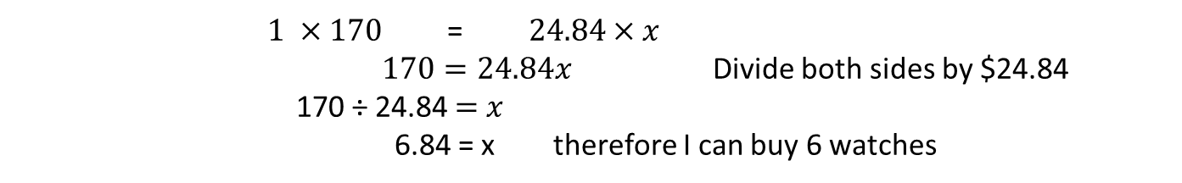
Exchange rates are used to work out how much something is worth in another currency.
Example
$1 Aus : $1.08 NZ means that something that cost $1 in Australia costs $1.08 in NZ. These are proportionate. So how much would a watch cost in New Zealand if it is $23 in Australian dollars.
$x=\$24.84$
Now we know 1 watch costs $24.84, how many watches can I get for $170 NZ?
1:$24.84 x:$170
watches $
1 costs $24.84
x costs $170
$1 ×170$ = $24.84×x$
$170=24.84x$ Divide both sides by $24.84
170 ÷ 24.84 $=$ $x$
6.84 = x therefore I can buy 6 watches

Slide 10
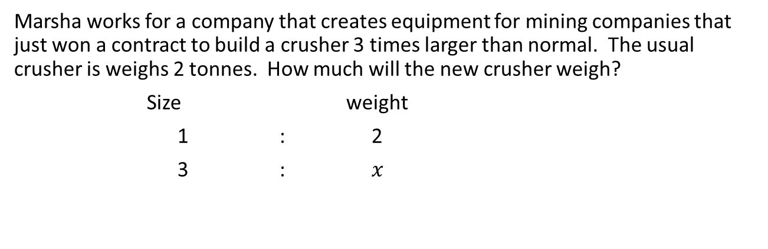
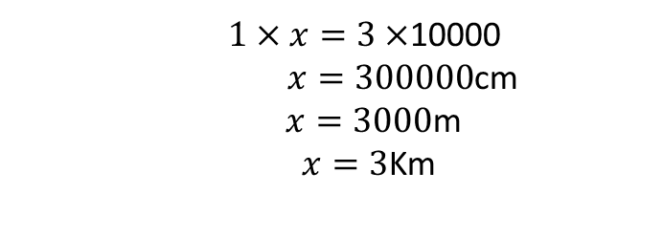
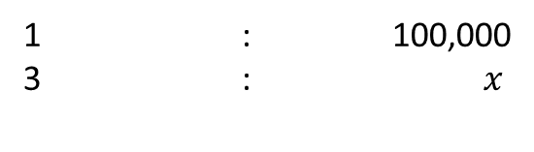

Marsha works for a company that creates equipment for mining companies that just won a contract to build a crusher 3 times larger than normal. The usual crusher is weighs 2 tonnes. How much will the new crusher weigh?
Size weight
1 : 2
3 : $x$
$$1×x=2×3$$
$x=6$ tonnes
Robbie is using a map to calculate distances. The distance between 2 places on the map is 3cm and the scale on the map is 1:100,000. How far apart are the two places really?
Map World
1 : 100,000
3 : $x$
$1×x=3×$10000
$x=300000$cm
$x=3000$m
$x=3$Km
Notes:
Use a fists of five or thumbs up to check for understanding.

Slide 11
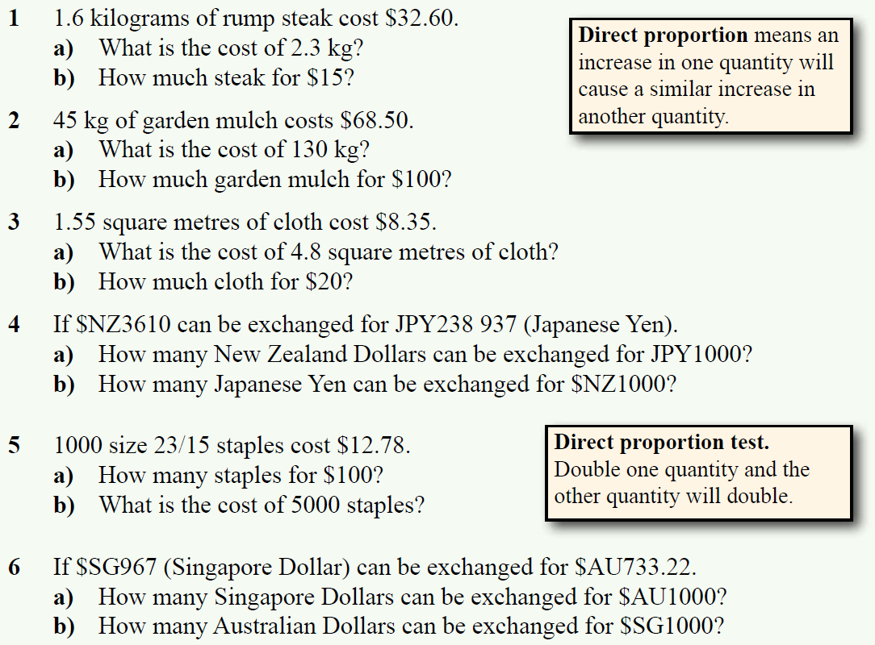
Complete Exercise 6.9 on page 81

Slide 12
Answers to Ex 6.9

Slide 13
Exit Pass.
IF Mark wants to buy a watch at $15 in US dollars, what would it cost in Australian $ given that $1 Australkian buys $0.75 US dollars?
Write your answer on a piece of paper awith your name on it and pass to your teacher.

